Slide 1


NFL - Player Draft Prediction Model
A predictive model that predicts a player’s selection into the team based on the player’s performance.

Slide 2
Problem Statement
To support university students attempting to progress their athletic careers by assisting them in determining their likelihood of being chosen by their present performance is the major objective.
Furthermore, we offer a comparative study between the player and the selected player so that the player may comprehend the extent of performance improvement.

Slide 3
What we intend to do
Data collection processing
Gather original data (scraping) from official NFL websites.
Clean and preprocess the data to address missing values, outliers, and inconsistencies.
Feature Engineering and Exploratory Data Analysis
Identify key parameters that impact the performance of the player.
Perform exploratory data analysis to understand data distribution, trends, and correlation.

Slide 4
Data Collection
We did web scraping to collect the data (Source: https://www.pro-football-reference.com/draft/2024-combine.htm)
We collected the data from year 2000 to 2023.
In our data we have 13 features and around 8800 rows.
We used BeautifulSoup a Python library to Scrap the data.
We stored the data in a data frame and later converted it to a .csv file.

Slide 5
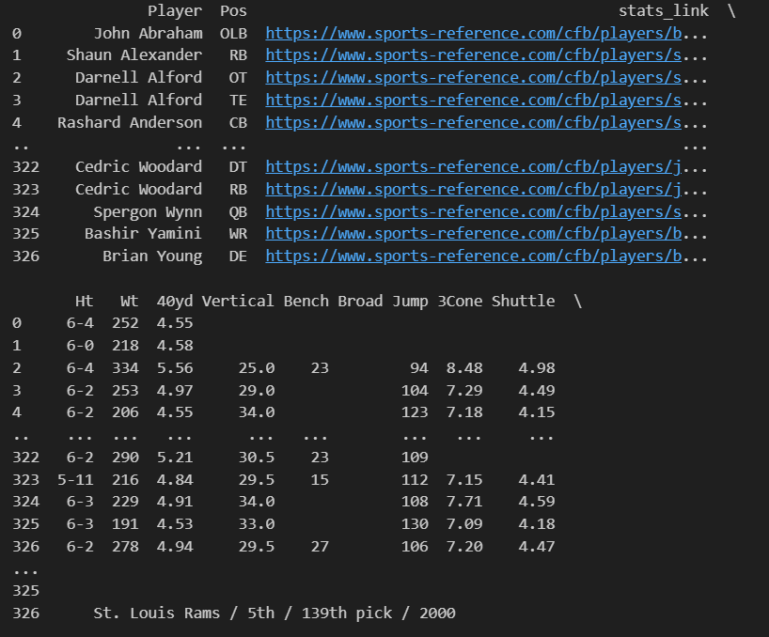
Web Scrapping Output

Slide 6
Description of Features
Features that are in the dataset:
Height – measured in feet - inch
Weight – measured in pounds
Position – Position of the player
40-yard Dash – measured in seconds (Time taken to cover 40 yards)
Vertical jump – measured in inches (High jump)
Broad jump – measured in inches (Jumping from one point to another)
Bench-press – measured in pounds (Max weight lifted)
3 cone drill – measured in seconds (Time taken to complete the drill)
20-yard shuttle - measured in seconds (Time taken to complete the drill)
Drafted – Yes or no

Slide 7
Data Cleaning
Handled null values based on player position and the important features required for that position.
Example: The position kicker 3 cone and shuttle are not important features. So, we removed rows with null values present in 3 cones and shuttle.
Finding and handling outliers. We found 40 yards had few outliers.
Manipulated height column into readable data.

Slide 8
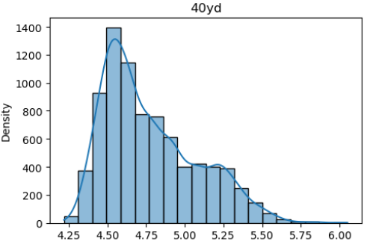
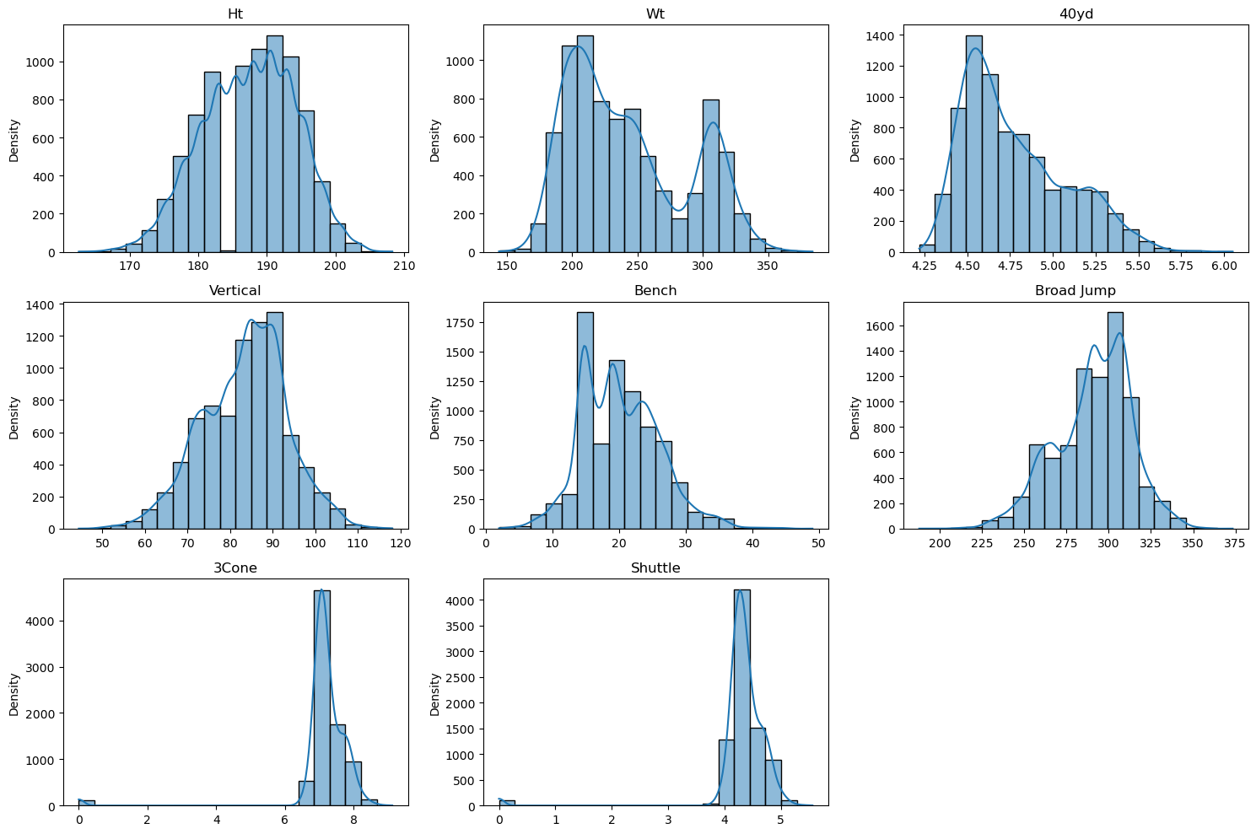
Outliers & Skewness
Some data is right-skewed

Slide 9
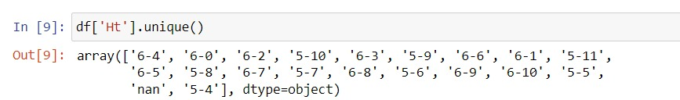
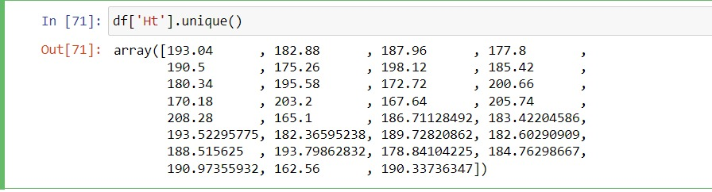

Slide 10
Feature Engineering
We converted the Drafted column to 0’s and 1’s.
We made sure that all the data is aligned with the same units.
Created a new column BMI based on height and weight.
Created a new column year drafted based on the existing column.

Slide 11
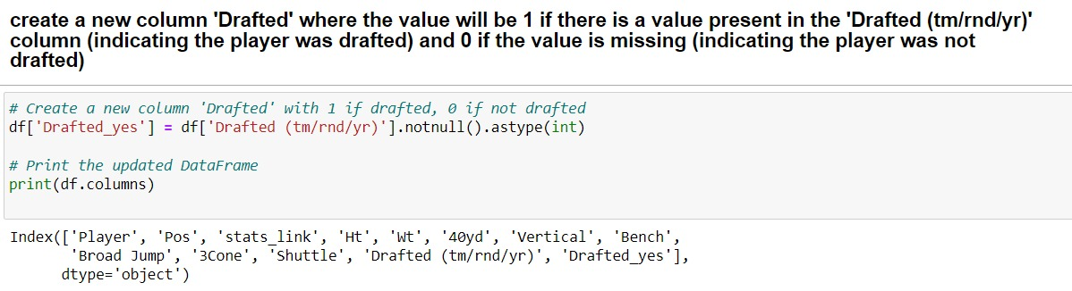
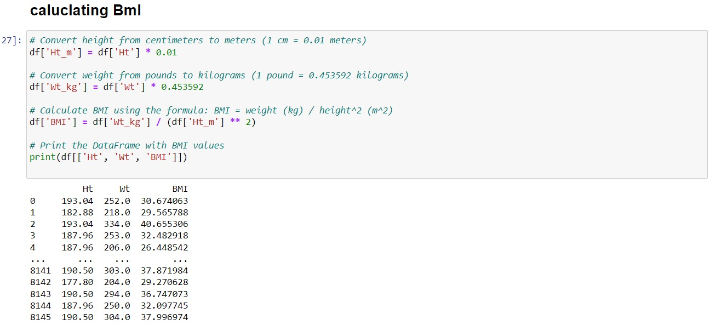

Slide 12
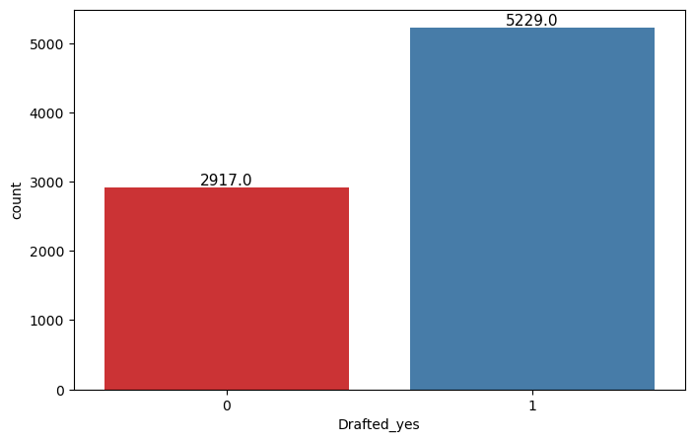
EDA
Created meaningful visualizations between features such as draft status count, position-wise draft status count, and univariant visualizations based on performance and draft status.

Slide 13
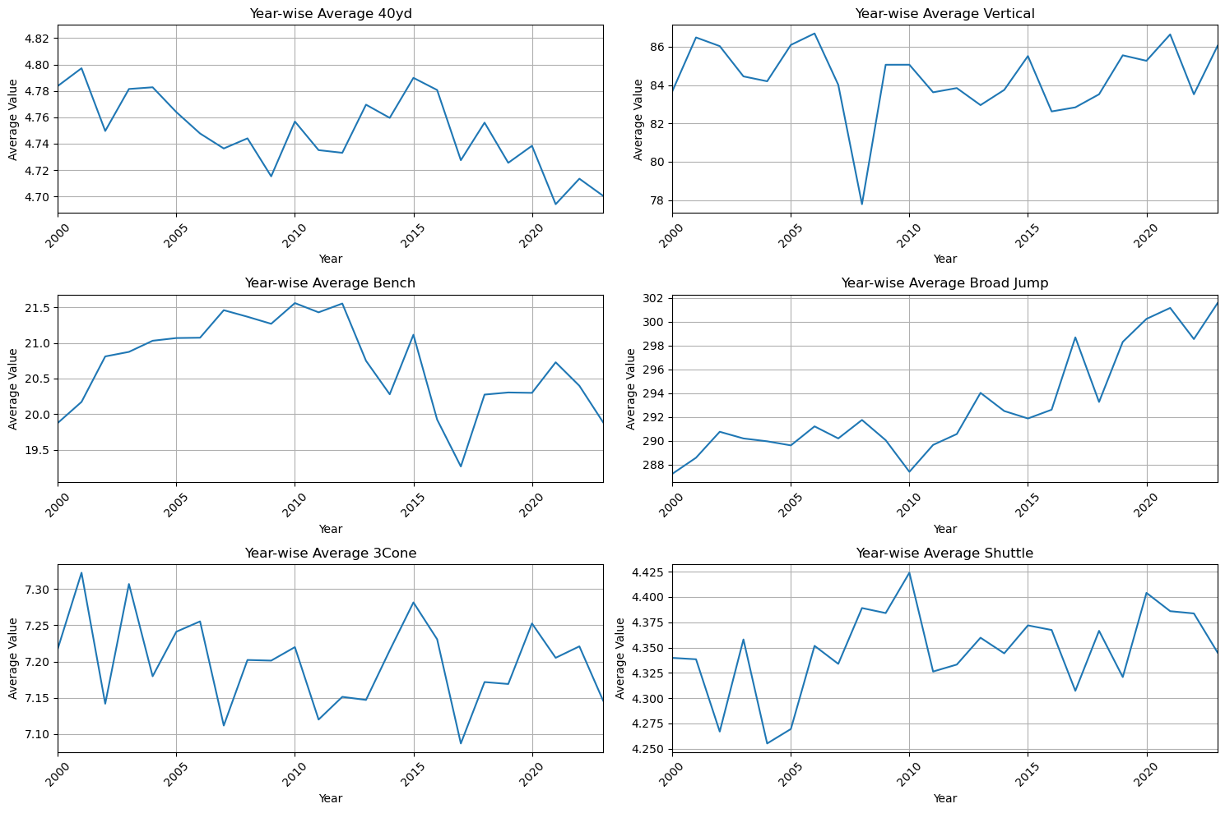
Year Wise Changes in Performance

Slide 14
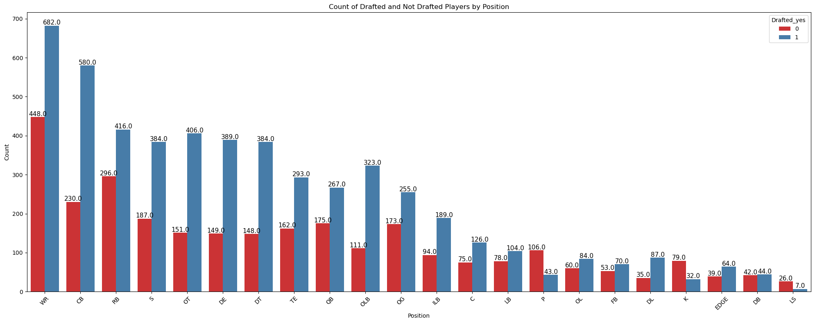
Drafted Status by Position

Slide 15
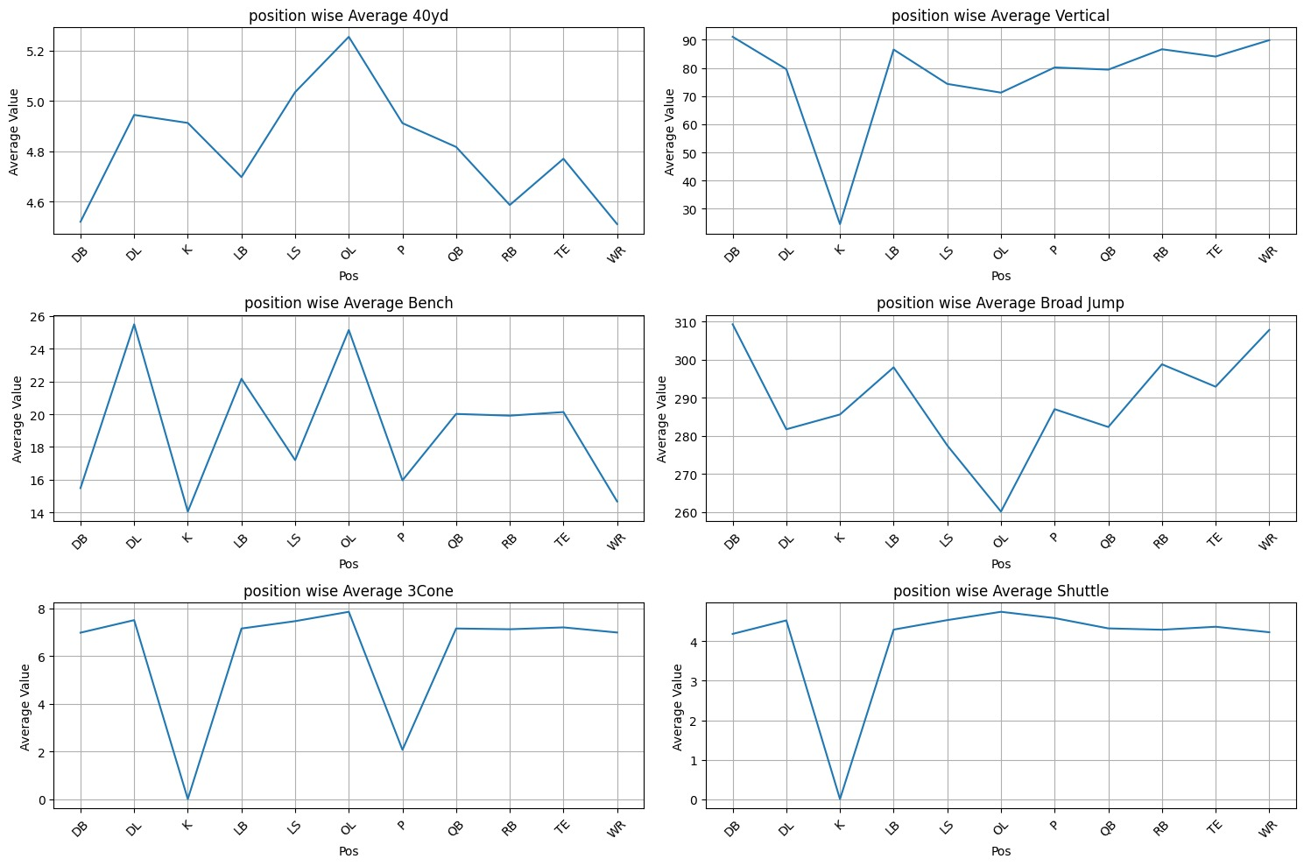
Performance Mean on Position

Slide 16
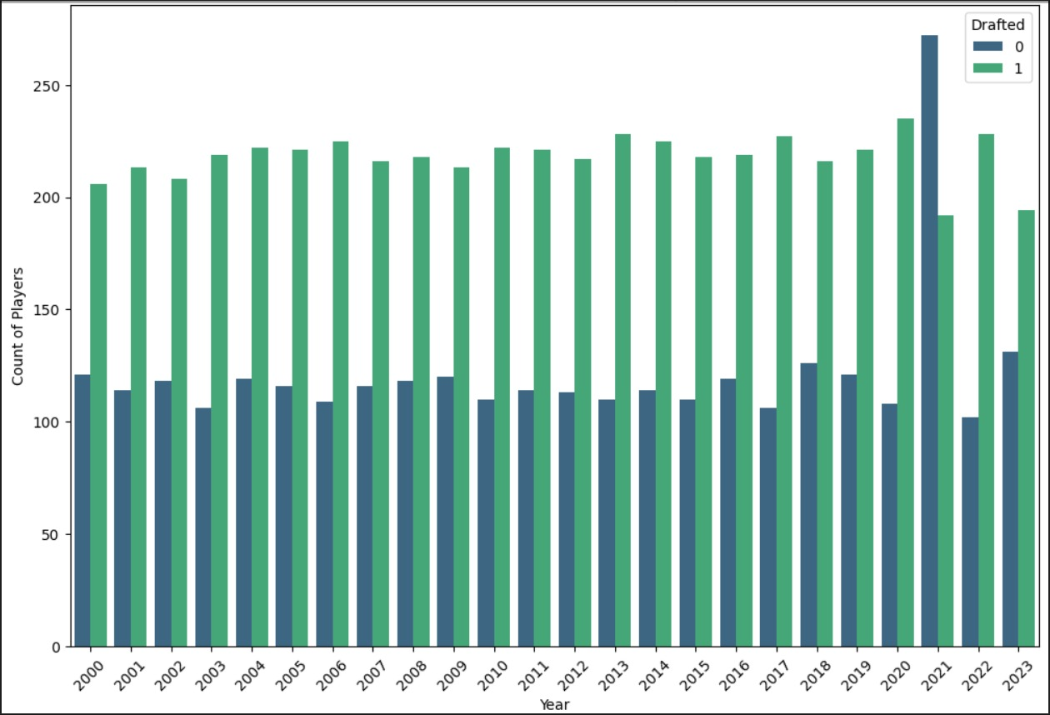
Year-wise draft/not drafted count

Slide 17
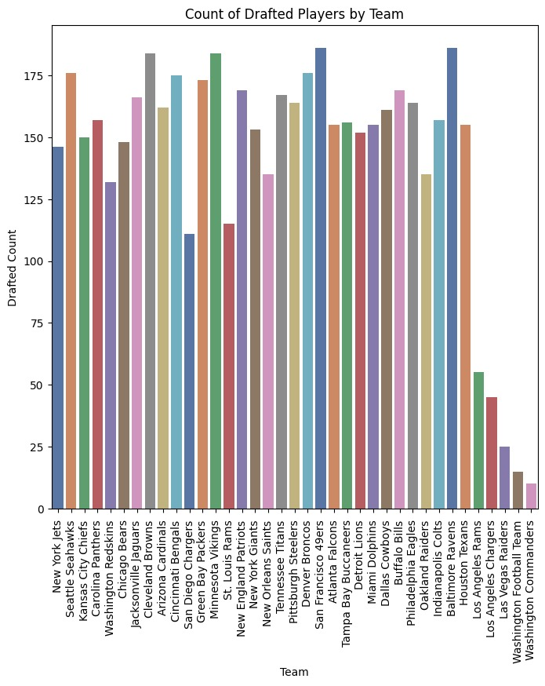
Count of drafted players by team

Slide 18
Splitting the Dataset
As the drill importance varies from position to position because different positions have different important drills.
So, we have decided to divide our dataset into sub-datasets based on positions

Slide 19
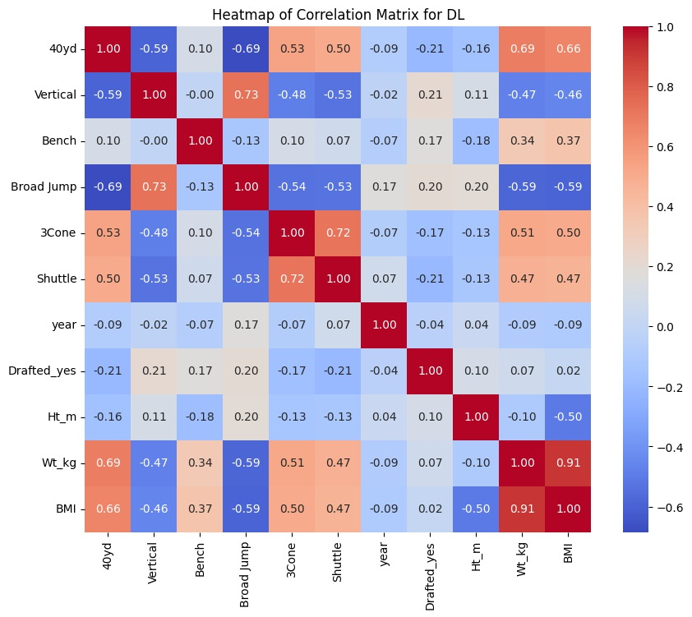
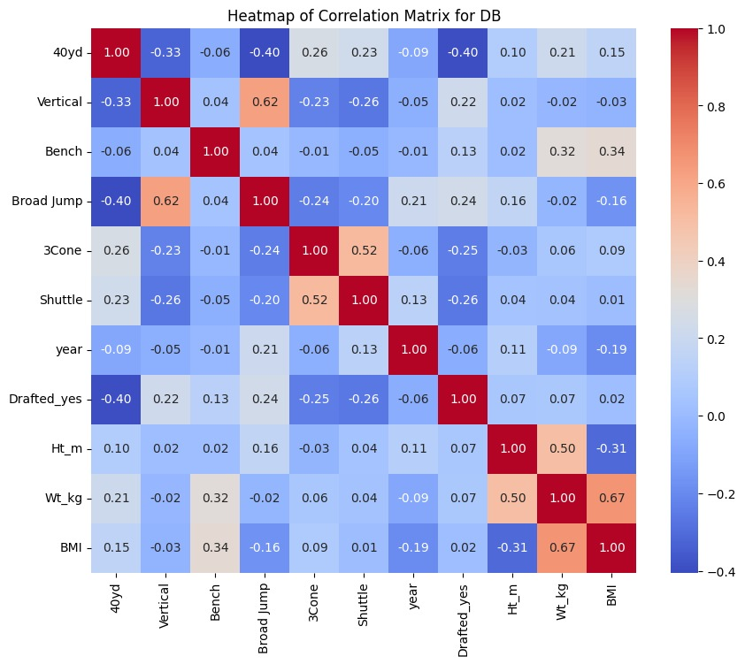
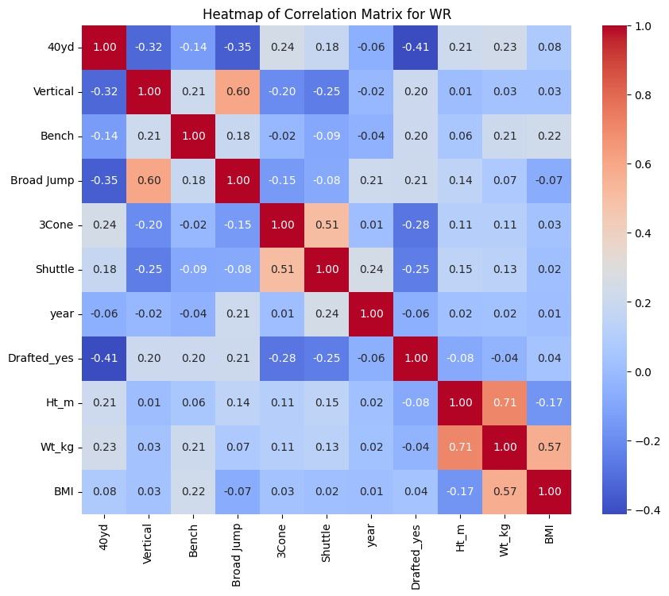
Heatmaps

Slide 20
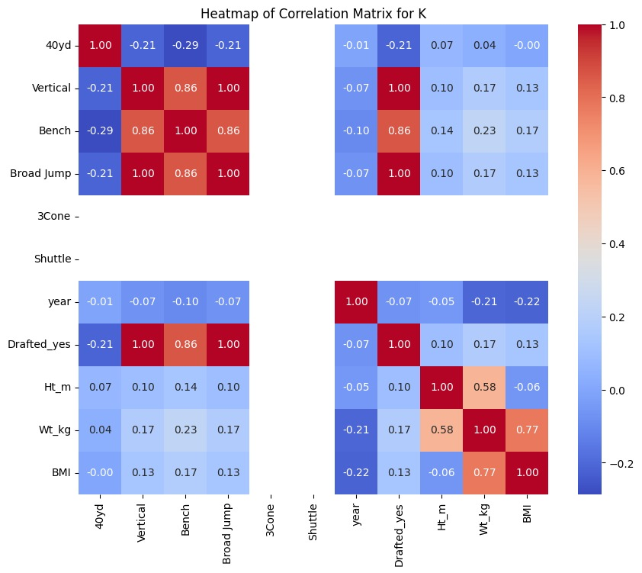
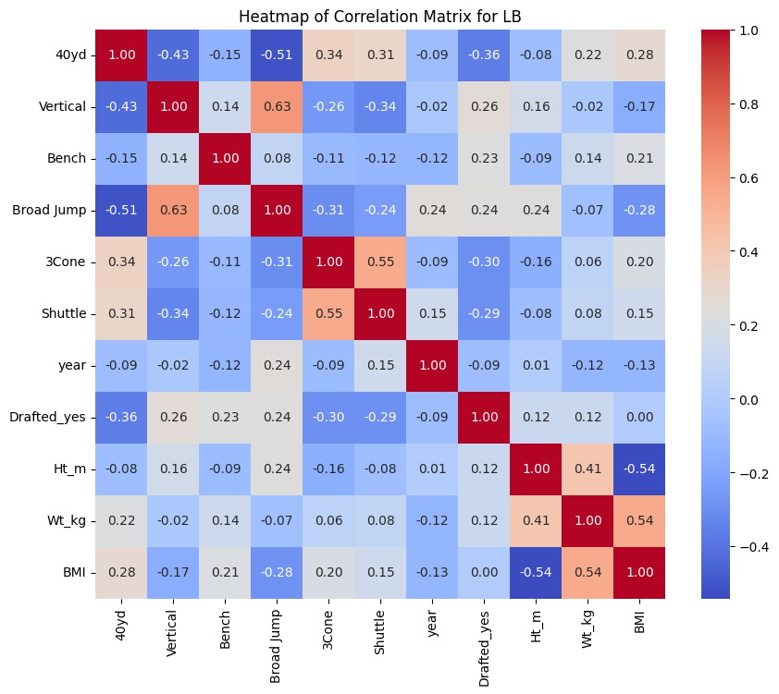
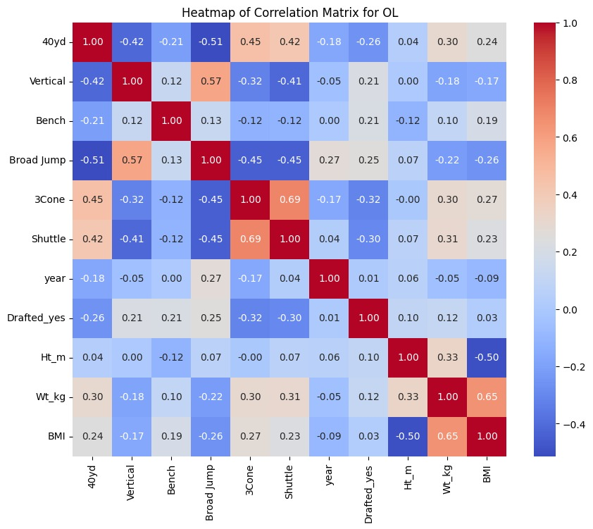
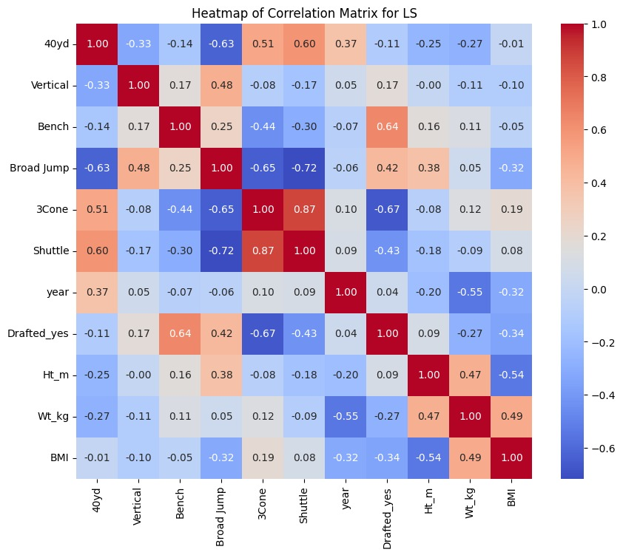

Slide 21
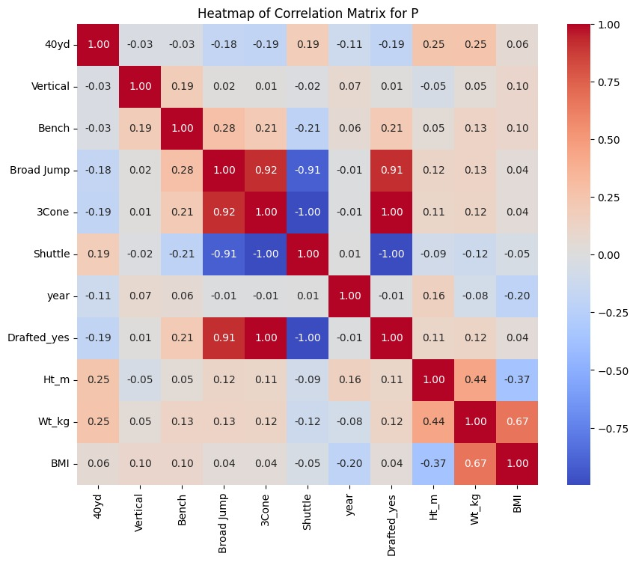
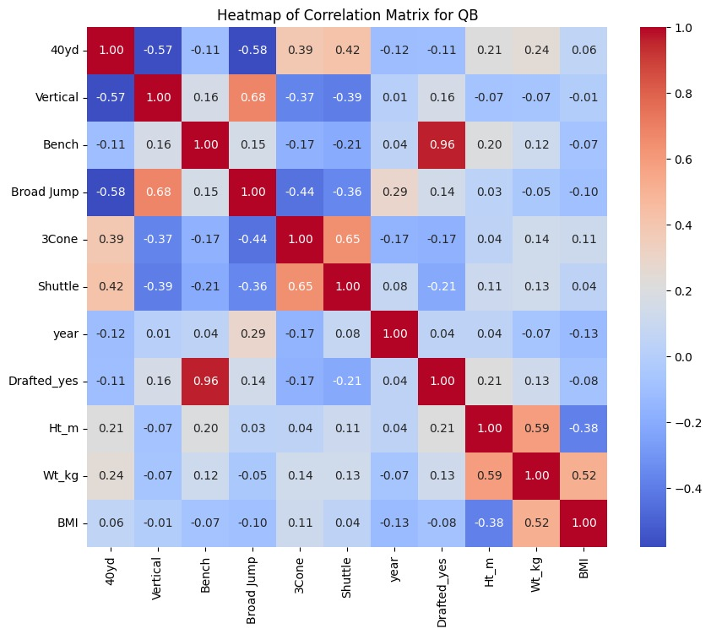
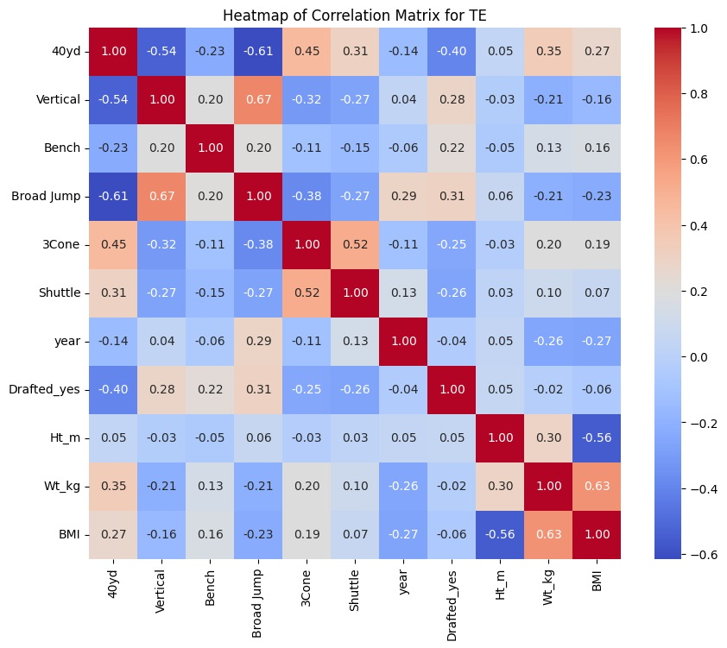
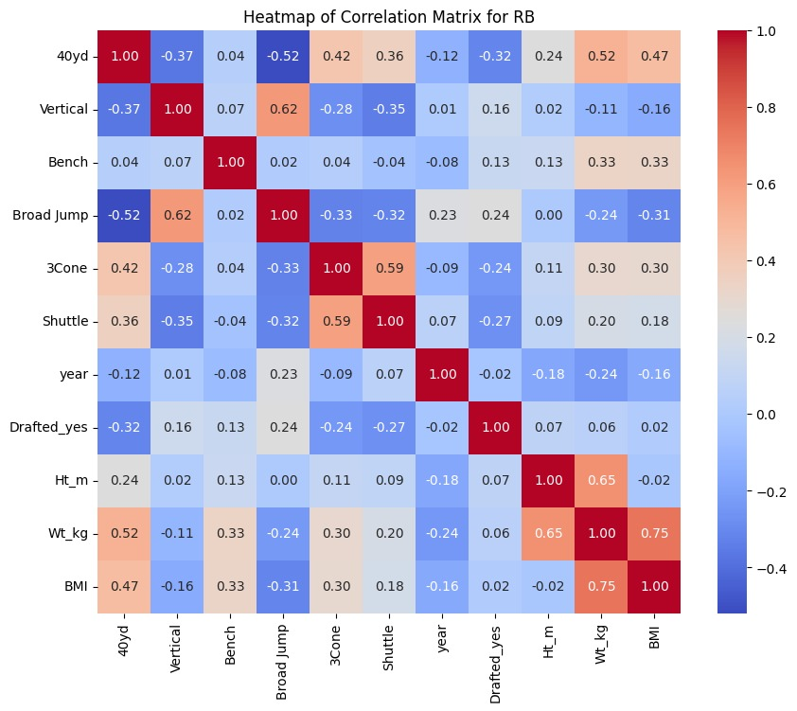

Slide 22
Feature selection
Based on the heat maps above, we chose three highly correlated columns as our features for each position respectfully to train and test the data.
LB': ['40yd', '3Cone', 'Shuttle'],
'RB': ['40yd','Broad Jump' ,'Shuttle],
'OL': [ '3Cone', 'Shuttle', 'Broad Jump'],
'TE': ['40yd', 'Broad Jump', 'Vertical’],
'DB': ['40yd','Shuttle','3Cone'],
'K': ['Vertical','Bench', 'Broad Jump’],
'P': ['Broad Jump', '3Cone', 'Shuttle'],
'DL': ['40yd','Vertical','Shuttle],
'QB': ['Bench', 'Shuttle', 'Ht_m',],
'WR': ['40yd','3Cone','Shuttle'],
'LS': ['3Cone', 'Bench', 'Shuttle']

Slide 23
Machine learning models
We trained in different models and we got the accuracies mentioned below:
Random forest classifier
Logistic regression
Decision tree classifier
KNN classifier
Voting classifier 1(Logistic regression, decision tree, KNN)
Voting classifier 2(Logistic regression, random forest,KNN)
Ensemble method :Random forest performed well and we used hyperparameter tunning for the maximum depth of the tree, which obtained good accuracies for all the different positions.

Slide 24
RANDOM FOREST CLASSIFIER
Results for DB: Accuracy: 0.82 Precision: 0.82 Recall: 0.82 F1 Score: 0.82 conf_matrix:[[ 66 34] [ 18 176]] | Results for DL: Accuracy: 0.78 Precision: 0.77 Recall: 0.78 F1 Score: 0.78 conf_matrix:[[ 37 32] [ 25 165]]
Results for K: Accuracy: 1.00 Precision: 1.00 Recall: 1.00 F1 Score: 1.00 conf_matrix:[[15 0] [ 0 8]] | Results for LB: Accuracy: 0.81 Precision: 0.81 Recall: 0.81 F1 Score: 0.81 conf_matrix:[[ 43 23] [ 11 103]]
Results for LS: Accuracy: 0.86 Precision: 0.89 Recall: 0.86 F1 Score: 0.85 conf_matrix:[[4 0] [1 2]] | Results for OL: Accuracy: 0.74 Precision: 0.74 Recall: 0.74 F1 Score: 0.74 conf_matrix:[[ 54 35] [ 34 143]]

Slide 25
RANDOM FOREST CLASSIFIER
Results for P: Accuracy: 1.00 Precision: 1.00 Recall: 1.00 F1 Score: 1.00 conf_matrix:[[23 0] [ 0 7]] | Results for QB: Accuracy: 0.98 Precision: 0.98 Recall: 0.98 F1 Score: 0.98 conf_matrix:[[37 2] [ 0 50]]
Results for RB: Accuracy: 0.81 Precision: 0.81 Recall: 0.81 F1 Score: 0.81 conf_matrix:[[50 13] [19 85]] | Results for TE: Accuracy: 0.73 Precision: 0.72 Recall: 0.73 F1 Score: 0.72 conf_matrix:[[18 15] [10 48]]
Results for WR: Accuracy: 0.77 Precision: 0.77 Recall: 0.77 F1 Score: 0.77 conf_matrix:[[ 61 34] [ 18 113]]

Slide 26
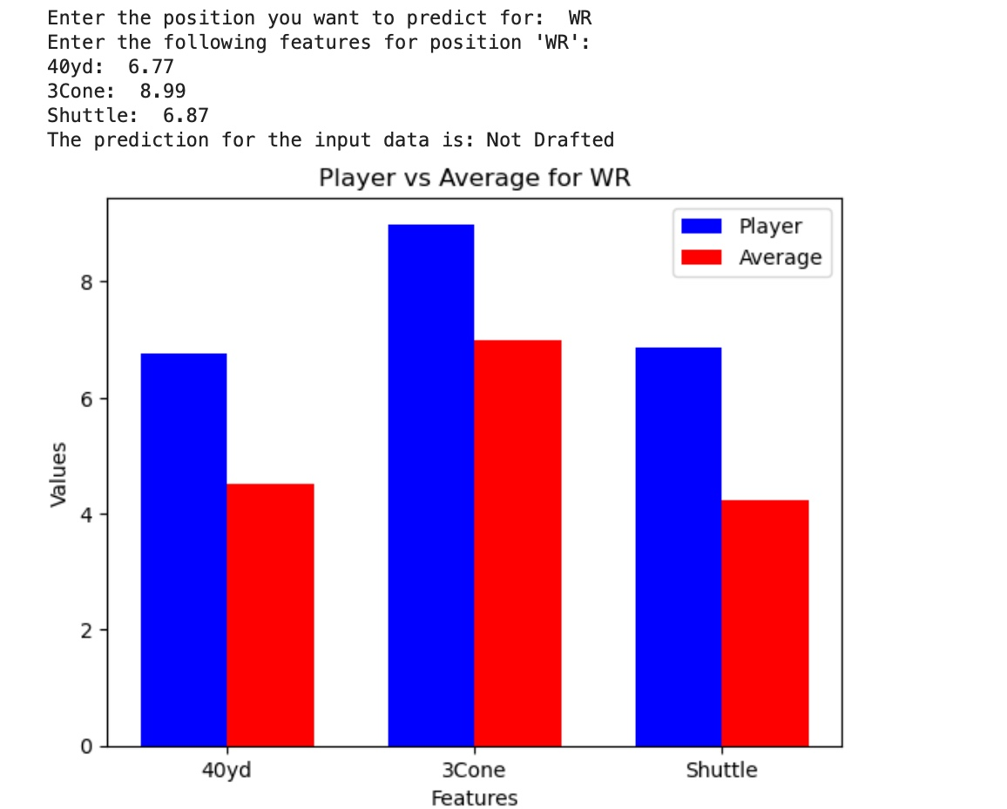
Testing The Model
We made the prediction processs user interactive for Players to input their position and performance in the drill to predict the draft status.

Slide 27
COMPARATIVE ANALYSIS
Based on the prediction “Drafted” and “Not Drafted”. If the player’s draft status is “Drafted” we are not doing any analysis.
If the prediction is “Not Drafted” then we are comparing the player’s performance with an Average drafted player over the years.

Slide 28
Use of Comparative Analysis
Development Focus:
It might be beneficial for the player to focus on improving agility and quickness, as indicated by the slower 3-cone and shuttle times.
Re-evaluation:
Since agility drills are key for positions requiring quick directional changes, re-testing in these areas after targeted training could provide better metrics to potential scouts.
Highlighting Strengths:
While working on weaker areas, it's also crucial to continue honing strengths like sprint speed, which is already above average.
Versatility and Skills:
Beyond physical metrics, enhancing route running, catching skills, and understanding of the game can also make a significant difference in a player's draft prospects.
Physical Conditioning:
Ensuring optimal physical condition through nutrition, strength training, and recovery practices could improve performance in future tests.

Slide 29
Thank You!!

